Slide 1
Influence Diagram
Prepared by
Said Fawzy
Manager of Information Center-Quality Manager
Tendering Department Arab Contractors

Slide 2
What is influence diagram ?
An influence diagram is an intuitive visual display of a decision problem.
It depicts the key elements, including decisions, uncertainties, and objectives as nodes of various shapes and colors.
It shows influences among them as arrows.

Slide 3
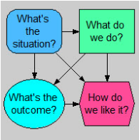
Simple Example
a decision
a chance variable
a final valuation
a chance variable

Slide 4





What do the nodes mean?
A decision is a variable that you (or your organization), as the decision maker, have the power to modify directly.
A chance variable is an uncertain quantity, whose value you don't (yet) know, because you don't have complete information
An objective is a measure of your satisfaction with possible outcomes.
A general variable is a deterministic function of the quantities it depends on.
An arrow denotes an influence.

Slide 5

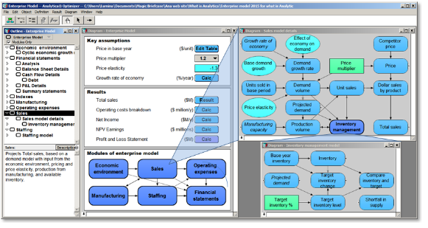
Famous software “ANALYTICA”

Slide 6
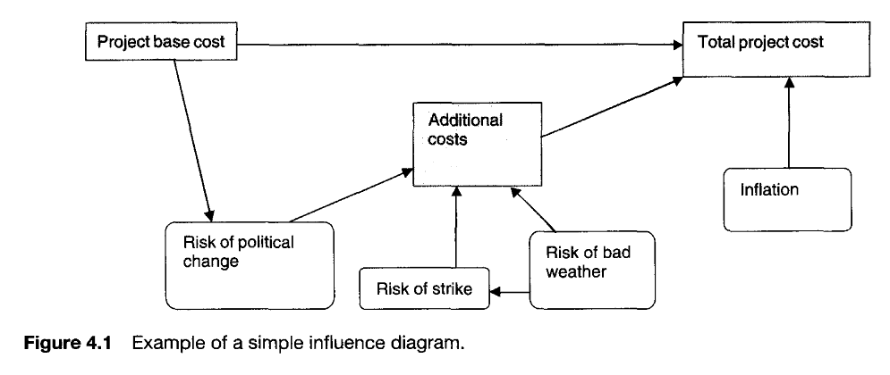

Slide 7

Example :
Project Mishaltit Hamada

Slide 8
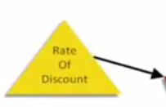

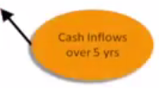


Slide 9
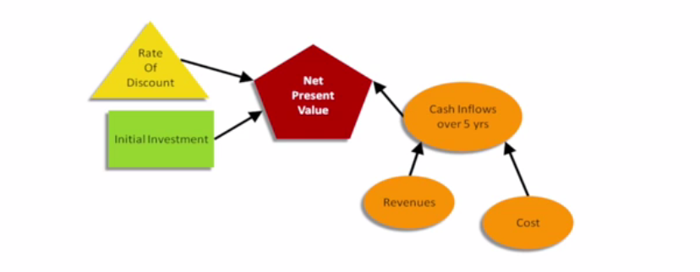




Slide 10
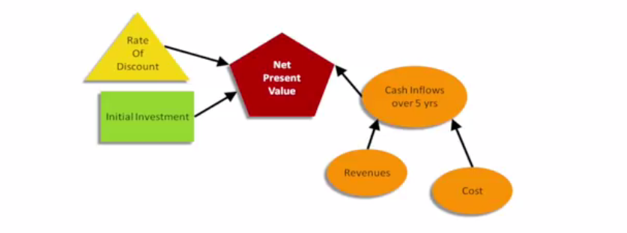

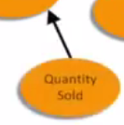

Slide 11
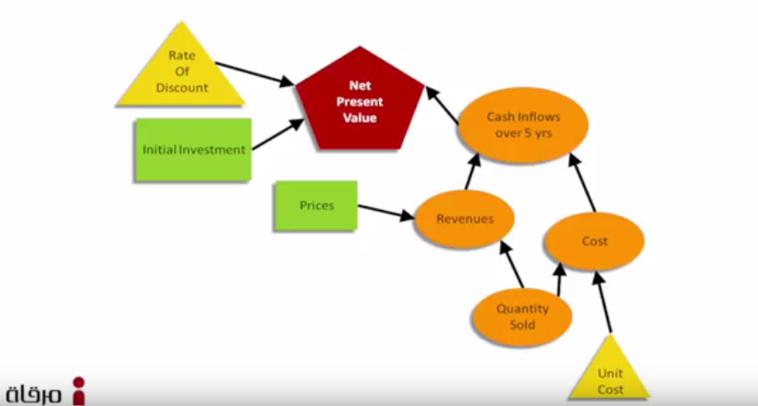

Slide 12
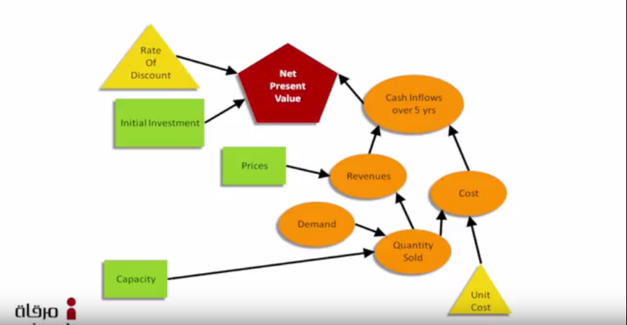

Slide 13
